Slide 1


Emergency Management Response System 2.0 (EMRS2)
FAD PReP
Overview of Capabilities
June 2021
1

Slide 2
Introduction EMRS2
EMRS2 is an interactive database used as USDA’s official system of record for animal health incidents and Foreign Animal Disease (FAD) investigations in United States.
States may request that premises data are imported into EMRS2 so that information is available to assist response operations in the event of an outbreak.
EMRS2 provides a secure yet accessible system for data collection, management, analysis, and reporting.

Slide 3
What can users do in EMRS2?
Users are assigned an access group which limits/determines the records they are able to access.
Users that have permission can enter data through streamlined wizards, also known as custom dialogs.
Federal and State veterinary medical officers, animal health technicians, and various disease specialists and epidemiologists (State and Federal), based on their role, will be able to
  collect, enter, and view animal disease data,
  manage activities like FAD investigations,
  manage and track resources (personnel & equipment),
  monitor progress of response operations,
  create reports, and
  create maps.

Slide 4
Ongoing Activities within EMRS2
FAD / Incident
Investigations
Tracing
Disease Management
Resource Management
Task Management
Trace Performance
Measures management
including tuberculosis (TB), brucellosis (BR) response activities, non-negative swine BR, pseudorabies virus (PRV).
for TB, BR, equine infectious anemia (EIA), equine piroplasmosis, PRV and cysticercosis.
for outbreaks such as highly pathogenic avian influenza, New World screw worm, cattle fever tick, rabbit hemorrhagic disease, virulent Newcastle disease
for management of personnel, supplies, equipment and fleet in all incidents.
for EIA Lab Inspection, Restricted Product Inspection, European Union (EU) Inspections, Animal Disease Traceability (ADTIS) Inspections, Garbage Feeder Inspections, contagious equine metritis (CEM) lab inspections, brucellosis testing (BTC) program mgt.
for demonstration of animal traceability for ADTIS.

Slide 5


Features of EMRS2
EMRS2 is a Model Driven Application operating on the Microsoft Power Platform:
  EMRS2Go Mobile
  EMRS2 Permitting
  Gateway
  EMRS2T
  Environment (Training)
  EMRS2 Production
  Environment (Live Data)

Slide 6
New Users Requesting EMRS2 Access
Obtain eAuth Level 2 credentials.
  For State users who need to create an eAuth account, it is best to request Level 1 eAuth first, then request to go from Level 1 to Level 2.
  Website: eAuthentication (usda.gov)
Complete Information Security Awareness (ISA) Training.
  Federal users: complete in AgLearn.
  State users: complete online and email a copy of your training completion certificate to EMRS Network Associates
Submit an APHIS 513 Form, signed by an USDA supervisor/representative.
  Both State and federal personnel.

Slide 7
EMRS2 Entities
EMRS2 Home provides the starting place for EMRS2 users. It references general announcements and training materials. Additionally, inspection tasks—used often by field employees—are managed here to help aid in organization and completeness.
Disease Management manages information related to incidents and investigations (e.g., premises statuses during an outbreak), providing actionable information, which allows rapid decisions to be made in order to protect U.S. agriculture, animal health, public health, the environment, and the economy.
Resource Management manages personnel and equipment deployed during an incident. During incidents, many activities are ongoing simultaneously and need to be tracked and positioned strategically for increased efficiency and coordination.

Slide 8
EMRS2 Entities
Knowledge Management manages documentation and makes it accessible to all users. It provides overarching information on incident response conducted within the National Response Framework as well as incident specific documentation from the field. EMRS2 training and job-aids are also available.
Enterprise Reporting provides tools needed to assist in creating the critical common situational picture amongst officials and responders. EMRS2 provides extensive capabilities for advanced queries and user generated reports. It can also spatially map premises and disease information, and offer targeted reporting for local, State, regional, or National audiences.

Slide 9
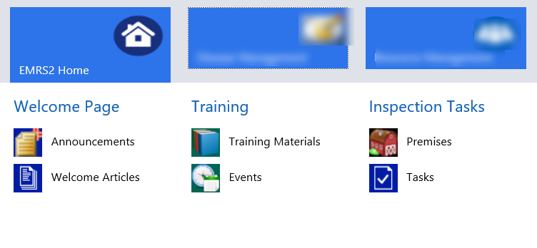
EMRS2 Home Entity
EMRS2 Home
  Welcome Page
  List of EMRS Network associates across the country.
  Training Materials Quick Reference Guides and other Training documents for user reference
  Inspection Tasks Incident and routine related tasks for assigned personnel.

Slide 10
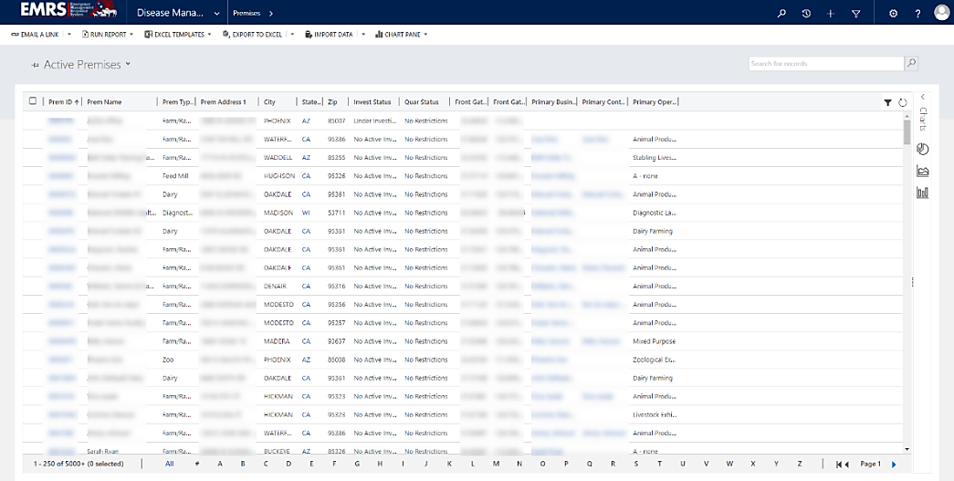
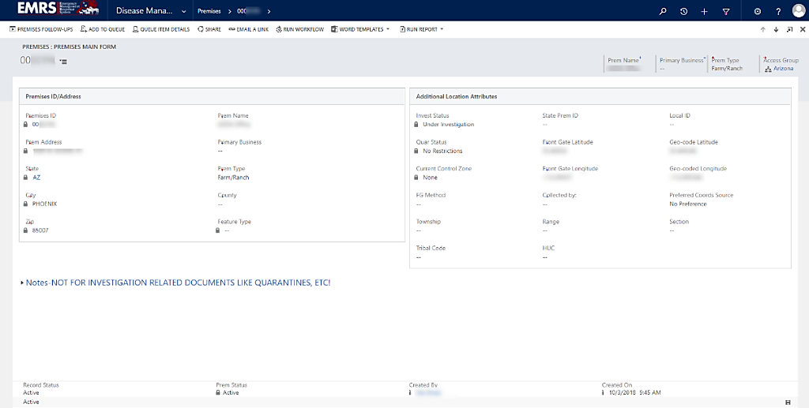
EMRS2 Disease Management Entity
Disease Management
  Premises
  Location information (Address/coordinates)
  Animal Businesses
  Business ownership (name) and contact
  Investigations
  Disease related events
Examples of “Premises ID”. On the main bar you need to click Disease Management, click premises and enter premises ID in the search bar. Once the premise comes up click on the premises ID or the arrow in the bar next to it.

Slide 11
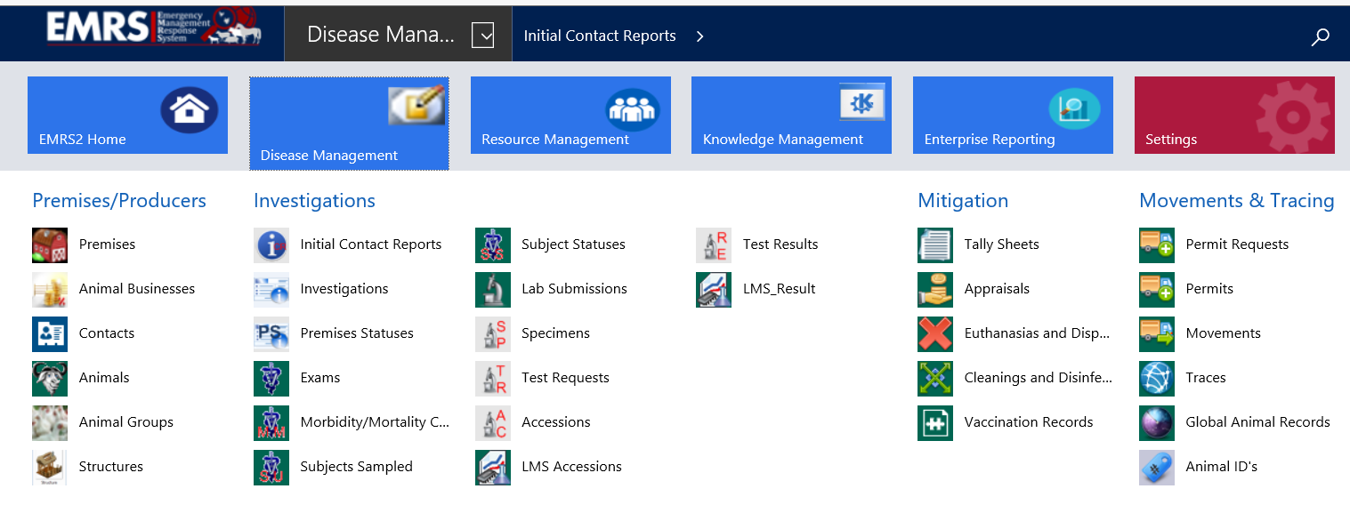
EMRS2 Disease Management Entity
Disease Management cont’d
  Exams
  Records visits to the
  premises
  Lab Submissions
  Records samples
  collected at the
  premises
  Laboratory Messaging System (LMS) Accessions
  Records results from the lab

Slide 12
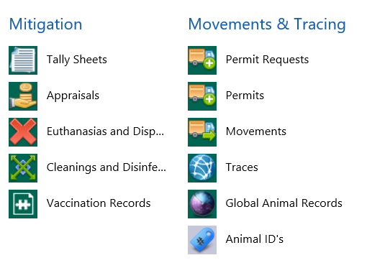
EMRS2 Disease Management Entity
Disease Management cont’d
  Tally Sheets
  Where the DRO records
  positive premises progress
  during an outbreak
  Appraisals
  Where the indemnity for the
  premises is tracked
  Permits
  Where SAHOs can view permits submitted by industry
  Traces
  Where district epidemiologists can track movements of animals on and off of the premises

Slide 13
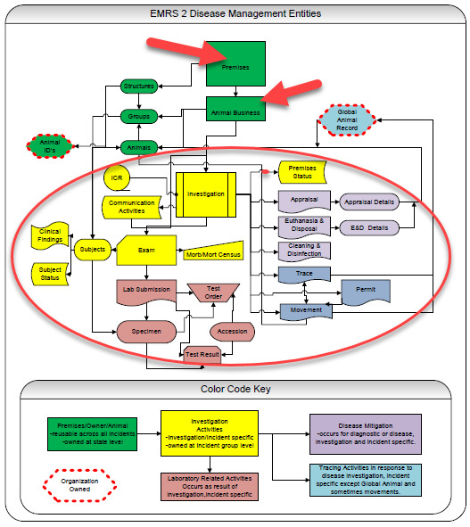
EMRS2 Workflow
It is similar as a family with offspring
Once opening an investigation these other entities open up
EMRS2 is a premises-based system
The premises acts as the parent
Investigation, Lab Submissions, Disease Mitigation, and Tracing are the children with additional components
All these functions work together
Notes:
Green-(Premises/Owner/Animal) Reusable across all incidents. Owned at state level.
Yellow- (Investigation/Activities) Investigation/Incident specific. Owned at incident group level.
Red- (Laboratory Related Activities) Occurs as result of investigation, incident specific
Purple- (Disease Mitigation) Occurs for diagnostic or disease, investigation and incident specific.
Blue- Tracing Activities in response to disease investigation, Incident specific except Global Animal and sometimes movements.
Red Dot- Organization Owned

Slide 14
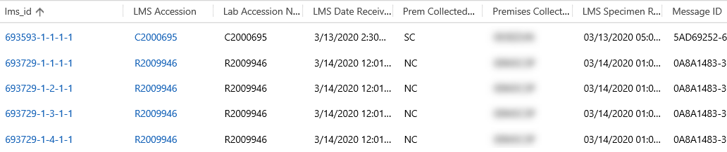
LMS Results Function
Electronically messaged (i.e imported) lab results from National Animal Health Laboratory Network (NAHLN) labs and National Veterinary Services Laboratories (NVSL) show up in the LMS Accessions feature
LMS result automatically links to the Premises ID
This allows for timely and accurate receipt of lab results

Slide 15
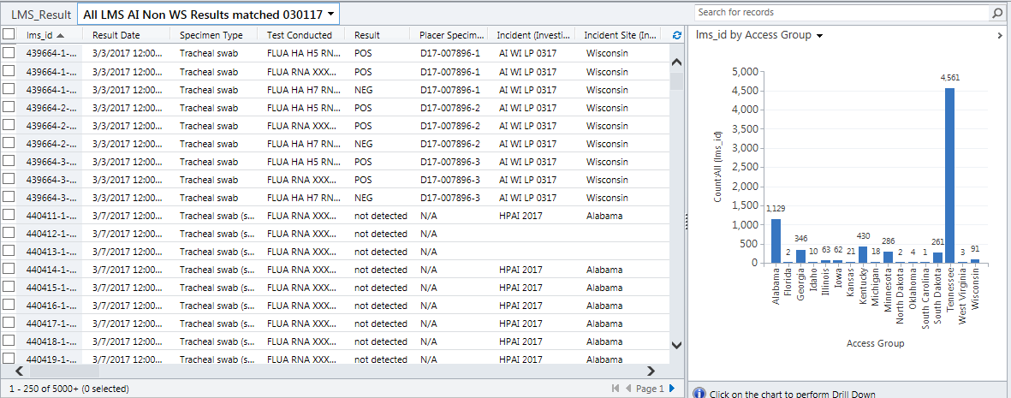
LMS Results Function
On-site Disease Reporting Officers (DRO) and USDA Veterinarians can now use these results to help make decisions on the status of not just that premises, but the incident response.

Slide 16
Tally Sheets Function
Tally Sheets are a significant part of managing an incident.
Tally Sheets are used by the Disease Reporting Officer, the Situation Unit Leader, and the National Situation Unit while responding to an animal emergency disease incident.
The information recorded on the Tally Sheet must be validated and updated throughout the incident.
After a Positive Diagnosis status has been created for a premises by the Disease Reporting Officer, a Tally Sheet is created.
The Tally Sheet documents critical tracking information for Infected and Dangerous Contact premises in summary form on a single page in EMRS2.

Slide 17
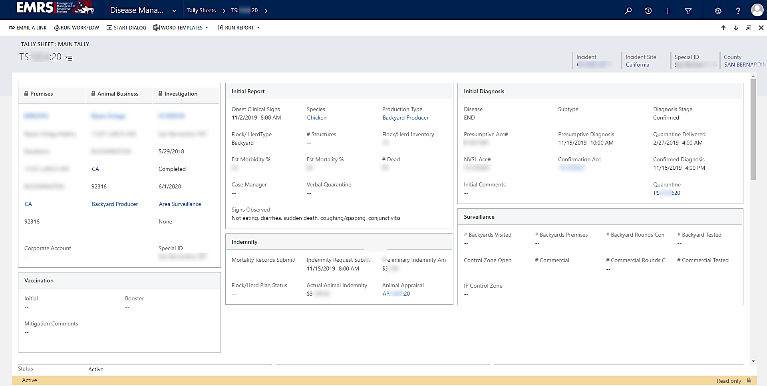
Tally Sheets Function
Links to Premises, Animal Business and Investigation
Contains sections on Indemnity, Surveillance, Disease Status, Clinical Signs, Vaccination, Euthanasia, Disposal, Cleaning, Disinfection, Release and Restocking.

Slide 18
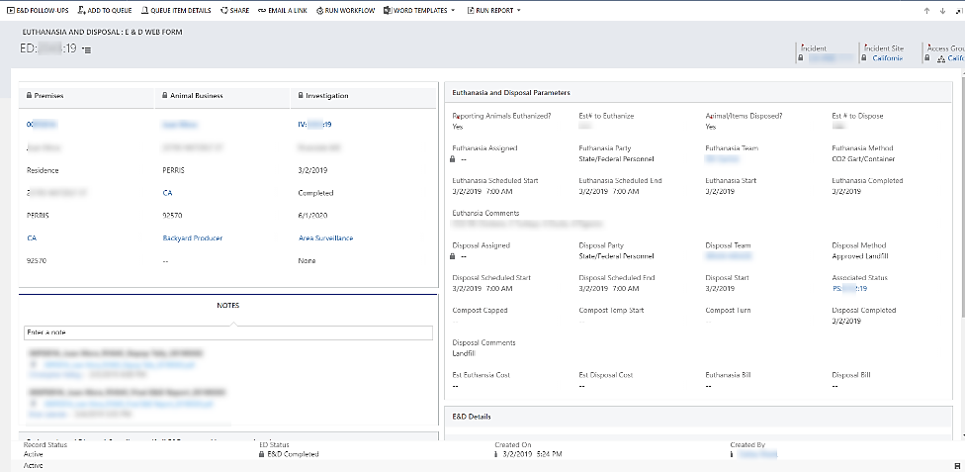
Depopulation, Disposal, and Disinfection Functions (3D)
Euthanasia and Disposal is created via the investigation record to accurately track documents for depopulation.
Cleaning and Disinfection is created similarly.

Slide 19
Permits and Permit Movement Functions
Permit Requests: Entry
- Through Gateway by Industry
- Manually by State or Federal employees
Permit Requests: Review
- Reviewed by State Animal Health Official
- Accept or Reject
Permits
State of Origin Reviews and Approves or Denies
State of Destination Approves or Denies in EMRS2
Movements
Industry enters Movements under approved Permits
Industry indicates the accession number of the required negative testing

Slide 20
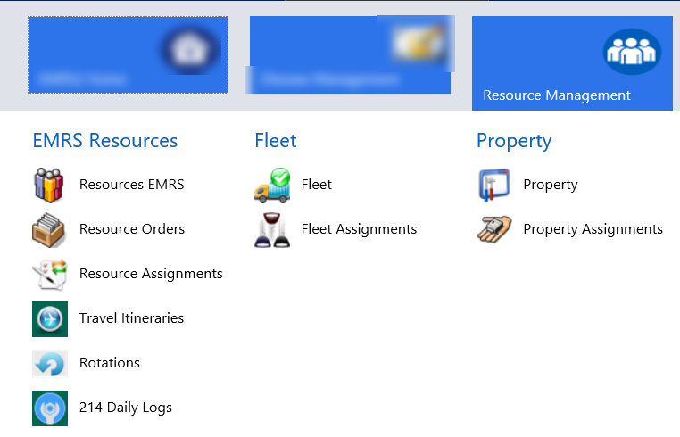
EMRS2 Functions and Entities
Resource Management
  EMRS Resources Personnel available for work to be assigned
  Resource Orders and Assignments Process requests for personnel
  Rotations Check personnel into and out of an incident
  214 Daily Logs Manage Case Manager 214s (Activity Log)
  Incident and Routine Track and Manage Fleet and Property

Slide 21
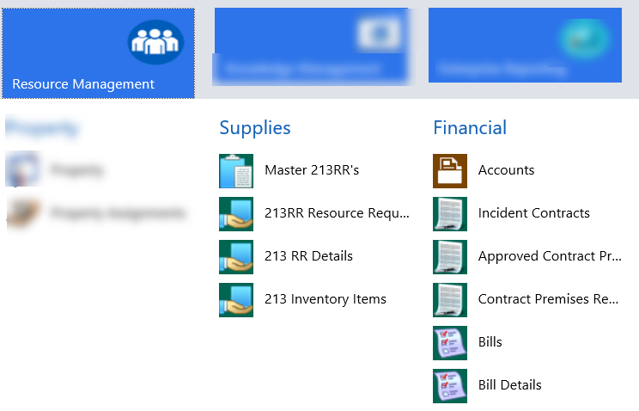
EMRS2 Functions and Entities
Resource Management continued
  213RRs Incident personnel set approval requirements for resource requests. The requests can be for supplies, Fleet, Equipment, Personnel, locally contracted Services and National Veterinary Stockpile (NVS) Catalog Items
  Financial Track and manage Incident Contracts
  213 Inventory Items View available items that can be requested
  Inventory Management for Supplies (in development)

Slide 22
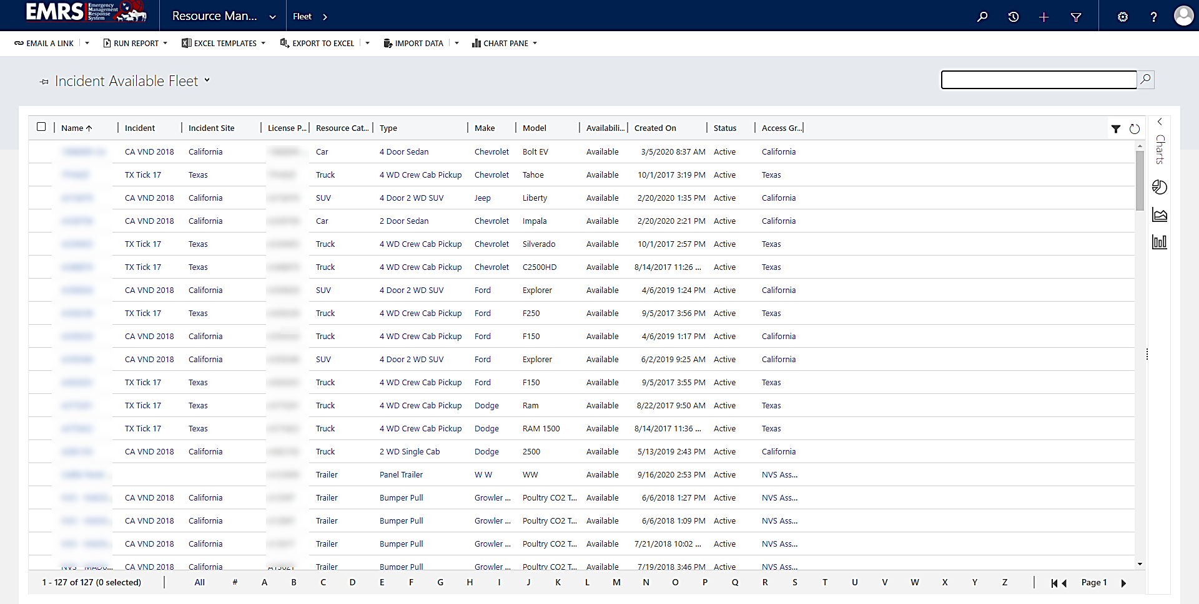
Resource Management: Fleet
Above is an example of how vehicles would be handled on an incident. The vehicle’s licenses plate number, model, and make would be recorded. As well as which individual it was assigned to.
Personnel assigned to the incident are also managed in the Resource Management Entity.

Slide 23
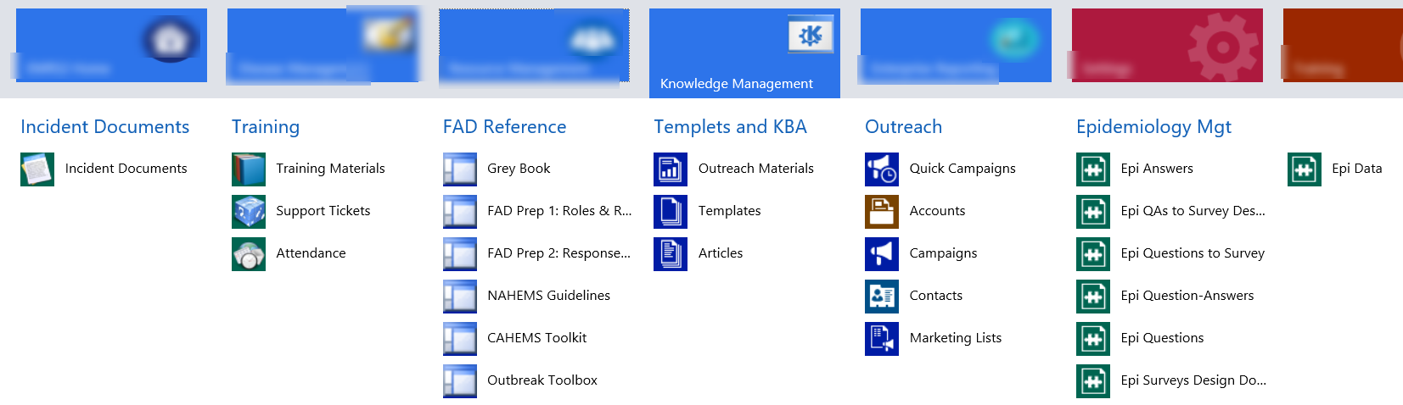
EMRS2 Functions and Entities
Knowledge Management
  Incident Documents Digital versions of all documents created by the incident is stored
  Training Materials You can find many instructions on how to navigate EMRS2
  FAD Reference Documents USDA policy documents
  Epidemiology Management Stores Epidemiology Questionnaires

Slide 24
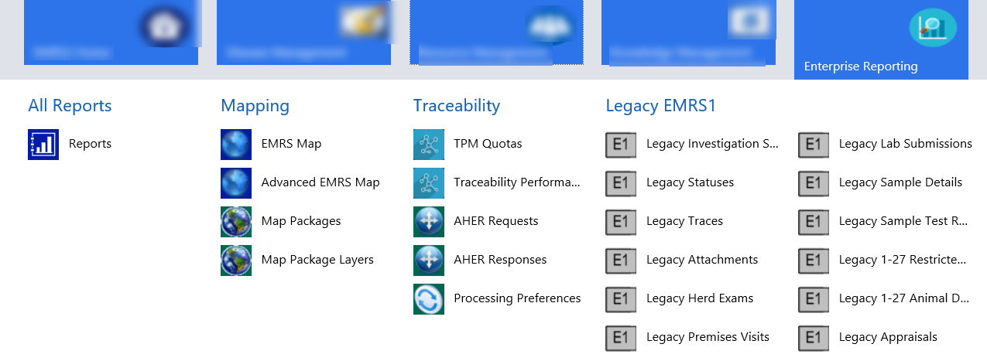
EMRS2 Functions and Entities
Enterprise Reporting
  Mapping Incident epidemiologist can create a visual overview of incident
  Traceability Where animal ID information is recorded/synced from the Animal Health Events Repository (AHER)

Slide 25
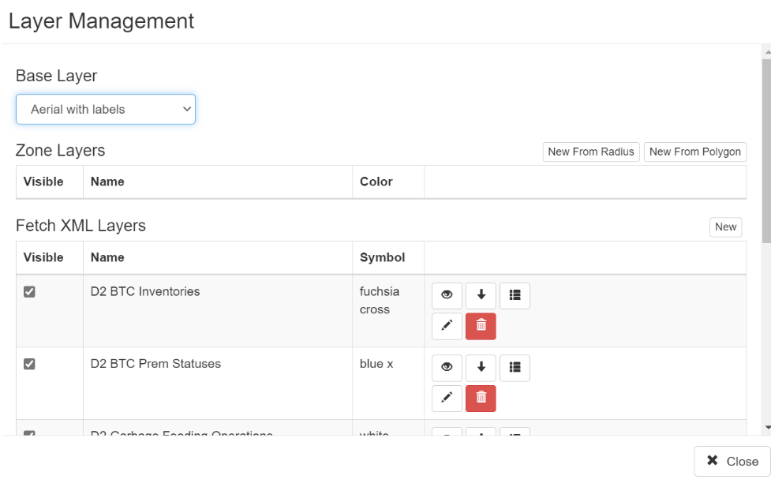
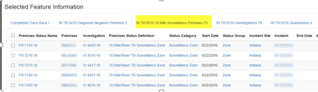
Map Packages Function
In advance mapping you can create incident specific maps.
Disease Management components are used to create mapping layers.
You can use the map to reference specific premise activities

Slide 26
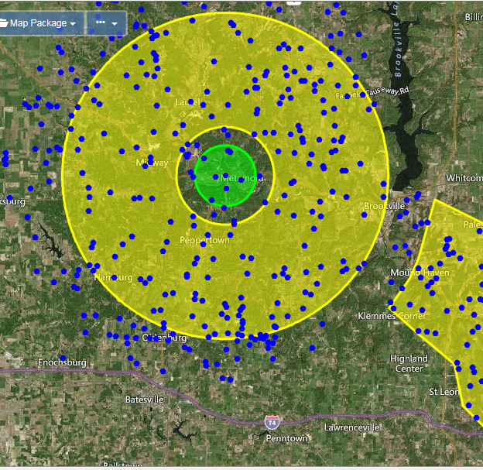
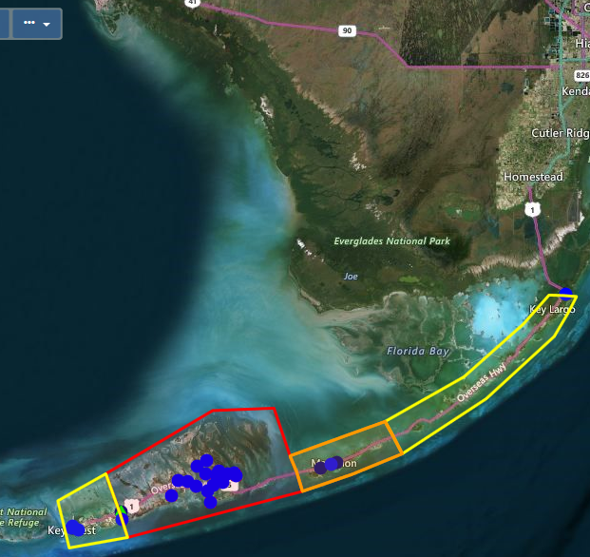
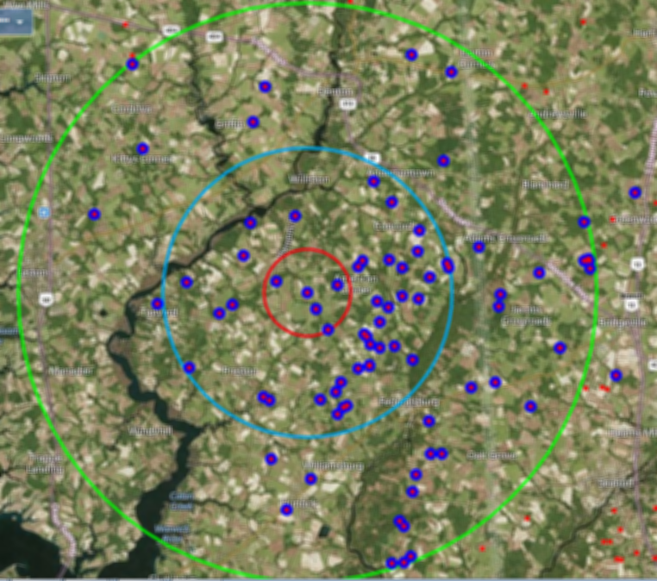
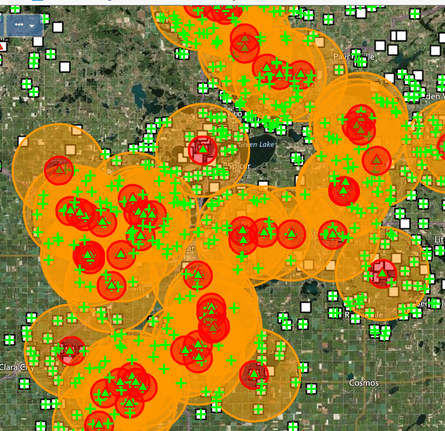
Mapping Examples
These maps include incident specific zones that were created in EMRS2.
EMRS2 automated zone management functions will status any premises with an investigation for the incident with Zone statuses linked to IP Control Zone status.
A single premises may be in multiple control zones.

Slide 27
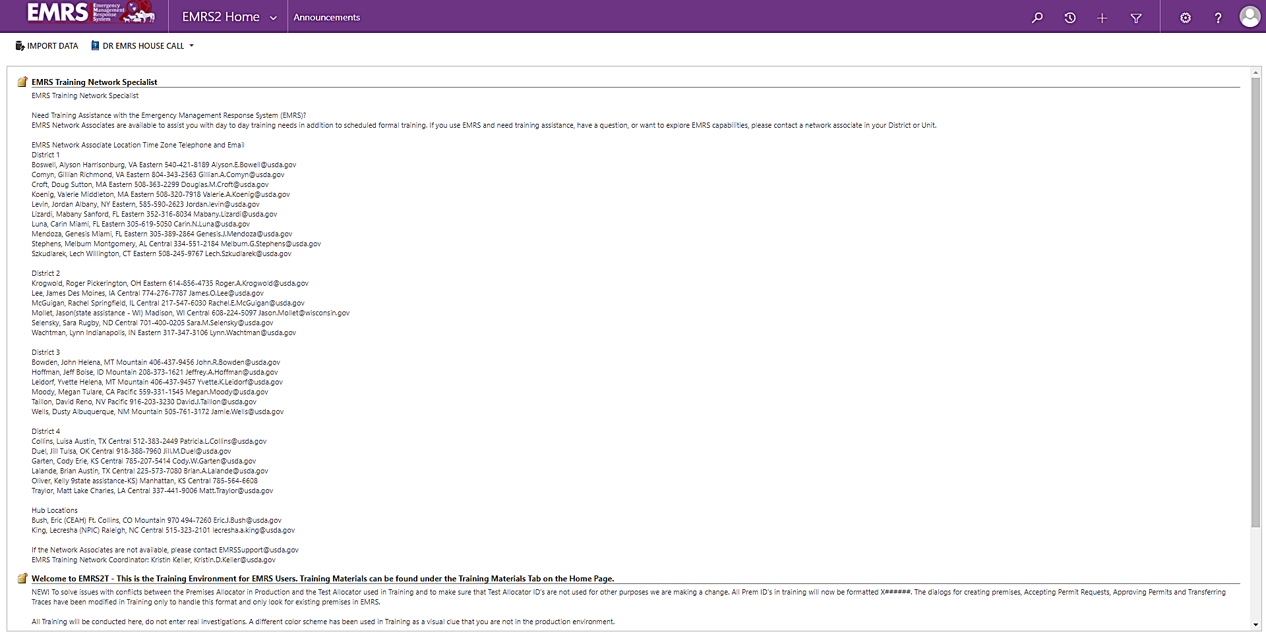
EMRS2T
EMRS2T is a training version of EMRS2 and is often used in exercises
The setup and layout is the same as the live EMRS2 database
Provides all of the same functions except what you do here does not impact what happens in EMRS2
You can tell if you are in the training by the color of the ribbon on top.
Dark Blue= Live EMRS Purple= Training EMRS
Ribbon is purple

Slide 28

EMRS Applications

Slide 29
EMRS2Go
EMRS2Go is an application that allows users with EMRS2 access to quickly and easily capture information associated with Surveillance visits including Diagnostic Sampling
  The application uses MANY drop down lookup menus allowing the user to quickly select and complete the required information.
Once downloaded and sync’d on the user’s laptop, the Surveillance/Diagnostic visit information is entered into EMRS2Go without an internet connection required – therefore the application can be utilized in the field, in real time.
EMRS2 User account is required to utilize the EMRS2Go application

Slide 30
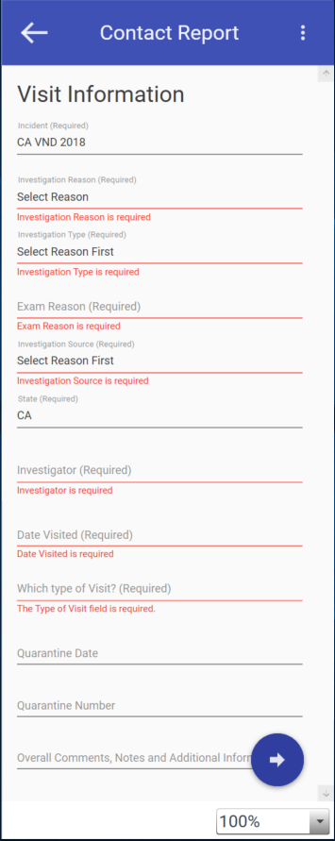

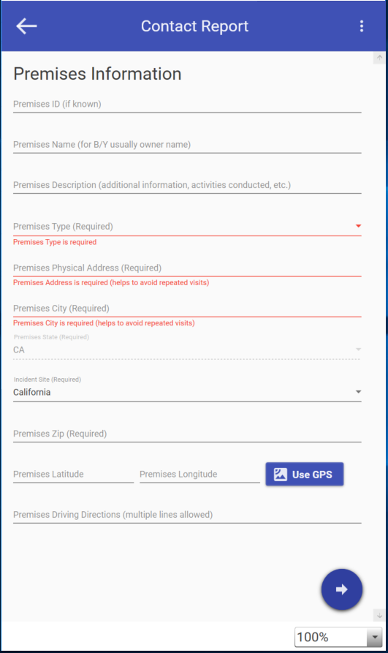
EMRS2GO
Streamlined offline mobile interface for entering FAD and surveillance visits.
When uploaded creates all necessary forms without additional data entry. (Example: Contact Report)
Cuts data entry time by 80% and training from days to less than an hour
EMRS2Go also has a training version

Slide 31
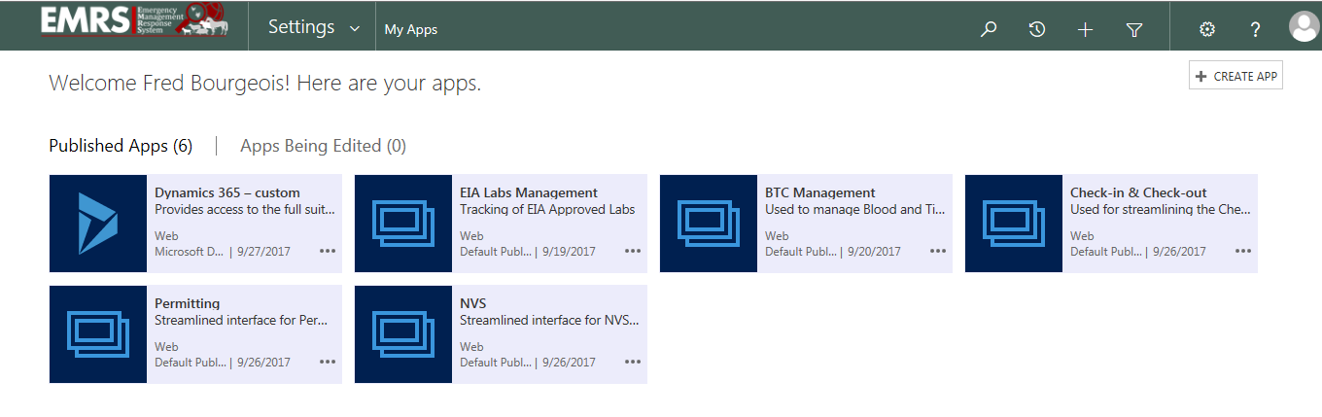
EMRS2 APPs
Microsoft Power version functionality allows for configuration of a very streamlined and highly focused interface for specific jobs using the underlying infrastructure.
This fast and easy configuration reduces training time and give users doing specific jobs a better experience without having to go through various EMRS2 entities to find their job function.

Slide 32
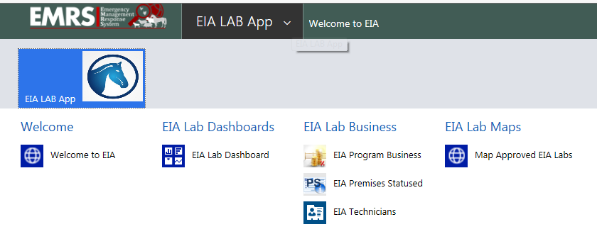
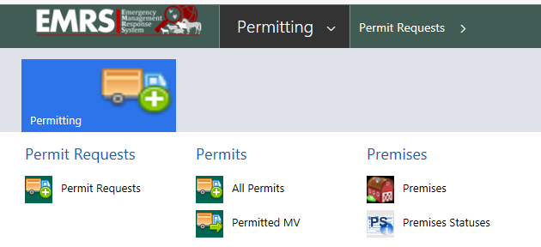
Customized APP Menu
Design can be very specific and focused for certain users and role based
Each app can have a specific URL for easy accessing by bookmarking in your web browser or downloading as a shortcut in your desktop.

Slide 33
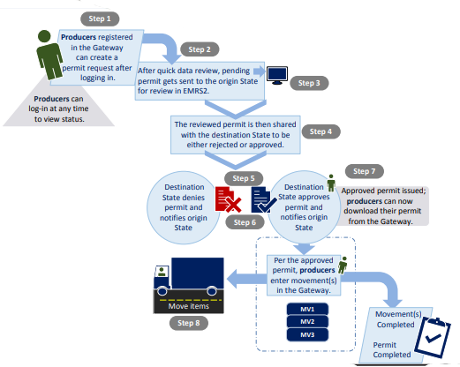
Customer Permit Gateway
Account- User Profile
Requires registration for E-Auth Level 1 credentials and a Gateway account must be created from EMRS2.
Built to allow industry to enter permit requests which go directly into EMRS2 for State review.

Slide 34
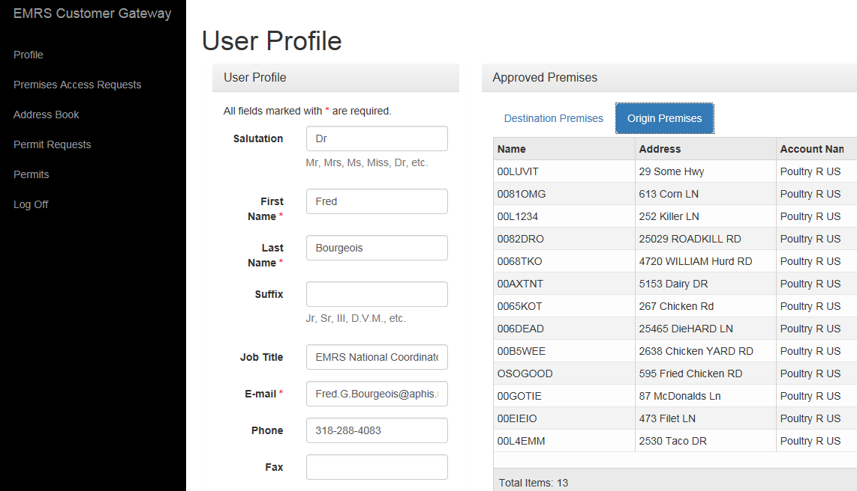
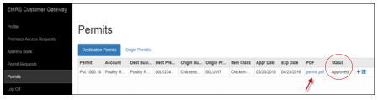
Customer Permit Gateway
How does the Gateway interact with EMRS2?
When a permit request is entered into the Gateway, it appears in the EMRS2 database automatically. State Animal Health Officials see the request in a queue and review the data for completeness. Requests are handled in the order in which they are received.

Slide 35
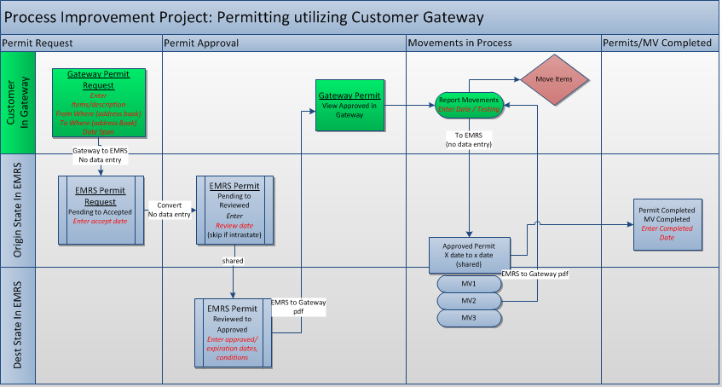
Permit and Permitted Movements Process
Permits and Permit Movement Functions
Above is the workflow of the Customer Permit Gateway.

Slide 36
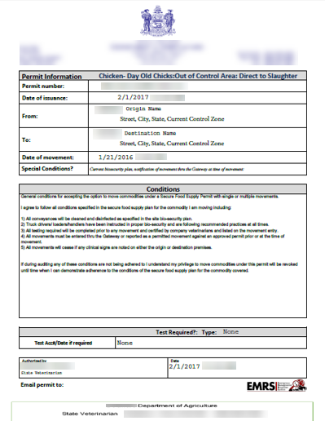
Customer Permit Gateway
Permitted Movement Document
A PDF is automatically generated with all information entered in the Gateway from movement including acc# and test dates. Example shown but actual document has the accurate premises and address information merged to the document.
Allows companies if approved to enter their testing and the amount and time of movements in real time and immediately have a PDF document for download attached to the movement they just entered.

Slide 37

EMRS Network Associates can be contacted at: emrs.training.network@usda.gov
You can also visit: USDA APHIS | Emergency Management Response System 2.0 (EMRS2)

